Slide 1
Configuration Management with Parts Unlimited MRP
[ speaker name]
[ speaker E-mail ]

Slide 2
Demo / Hands on lab
HOL_Deploying-Using-Chef
HOL_Deploying-Using-Puppet
Notes:
There is just not enough time to go over Configuration Management in 5-6 minutes here, it asks for several machines to be created and configured.
There are existing HOL around Parts Unlimited MRP that you can try if you want.
2 HOL of are of interest for Configuration Management, one is using Chef and the other one is using Puppet.
Links to the HOL will be shown later in the slides and I strongly invite you to complete them.

Slide 3
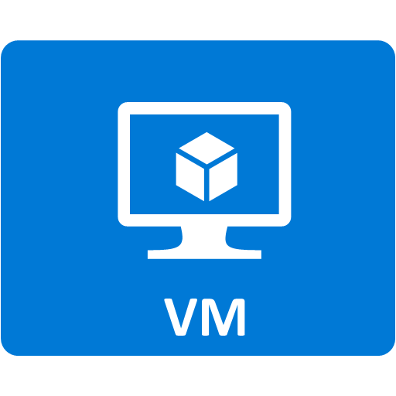
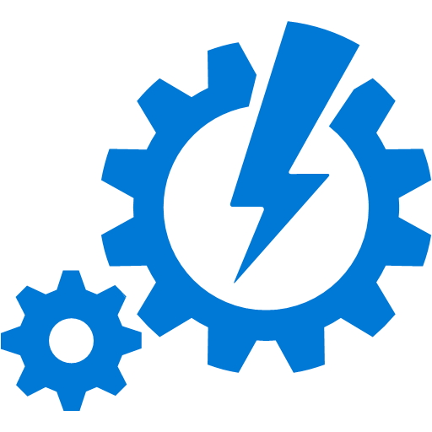
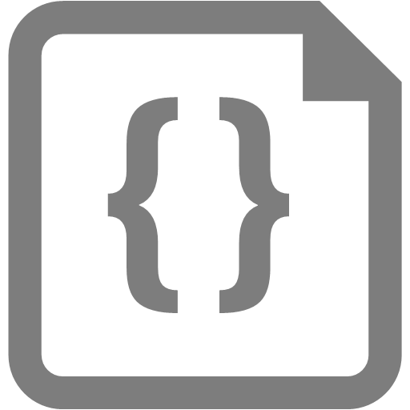
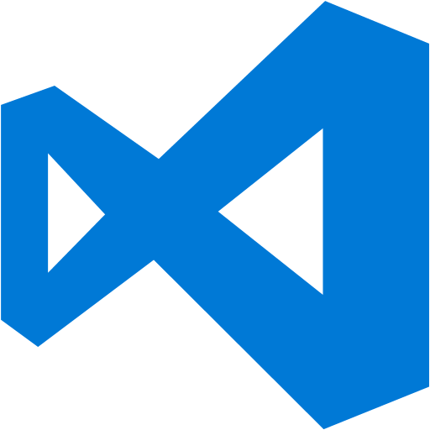
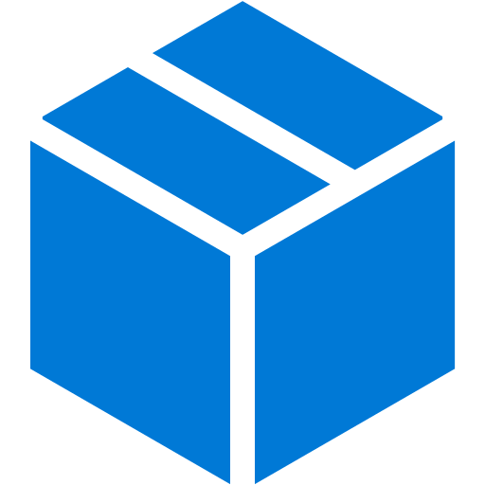

Confirmation Management examples
← →
DSC Configuration
AA DSC Pull Server
→
→
→
→
← →
→
Your Code
Puppet Configuration
PES
← →
Chef Configuration
Chef Server
Notes:
AA DSC Pull Server = Azure Automation DSC Pull Server
PES = Puppet Enterprise Server
Whatever the CM system you want to use, PowerShell DSC, Puppet or Chef, you do the same thing. You express a desired state and they (CM) take care of the applying that configuration for you. They can also detect and compensate configuration drifting. As an example: In Parts Unlimited MRP we use tomcat. Being backed with configuration drifting is a synonym of peace of mind. If a user ssh into our machine and stop the tomcat service for example, Chef or the other systems will be able to detect that kind of drift at their next interval check and remediate at the situation by starting the tomcat service without our intervention.
What is Chef??
Chef is a powerful automation platform that transforms infrastructure into code. Whether you’re operating in the cloud, on-premises, or in a hybrid environment, Chef automates how infrastructure is configured, deployed, and managed across your network, no matter its size.

Slide 4
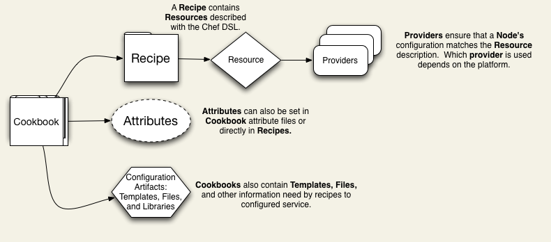
Cookbooks and recipes
Notes:
Chef has its own vocabulary and you’ll be hearing things like “cookbooks”, “recipes” & “knife” when dealing with Chef.
You can think of a Chef cookbook as a set of tasks to configure an application, in our case, it’s the Parts Unlimited MRP application. In a cookbook you define WHAT should be installed and HOW it should be installed.
A cookbook contains recipes which in turn are using resources. A Resource if backed by a Provider that do the actual work. It is not Chef itself that does all the configuration operations but the Resource’s providers
Chef is using the Ruby language.
Let take a look at the steps in the Parts Unlimited MRP recipe

Slide 5
Overview of the mrp recipe
#
# Cookbook Name:: mrpapp-2
# Recipe:: default
# Copyright (c) 2015 The Authors, All Rights Reserved.
# Runs apt-get update
include_recipe "apt"
# Add the Open JDK apt repo
apt_repository 'openJDK' do
uri 'ppa:openjdk-r/ppa'
distribution 'trusty'
end
# Install JDK and JRE
apt_package 'openjdk-8-jdk' do
action :install
end
apt_package 'openjdk-8-jre' do
action :install
end
# Set Java environment variables
ENV['JAVA_HOME'] = "/usr/lib/jvm/java-8-openjdk-amd64"
ENV['PATH'] = "#{ENV['PATH']}:/usr/lib/jvm/java-8-openjdk-amd64/bin"
# Install MongoDB
apt_package 'mongodb' do
action :install
end
# Install Tomcat 7
apt_package 'tomcat7' do
action :install
end
# Load MongoDB data
remote_file 'mongodb_data' do
source 'https://<git-repository>/raw/master/deploy/MongoRecords.js'
path './MongoRecords.js'
action :create
notifies :run, "script[mongodb_import]", :immediately
end
Notes:
Here is some of the content of the Ruby MRP recipe in Chef
You can see that we have package installation through apt_package for JDK, JRE, MongoDB & Tomcat
You can also see that we import data into mongo in the lower right of the slide.
This first part the of recipe is doing more the configuration of the machine, let’s see how the application is being deployed.

Slide 6
Overview of the mrp recipe
# Install the MRP app, restart the Tomcat service if necessary
remote_file 'mrp_app' do
source 'https://<git-repository>/raw/master/builds/mrp.war'
path '/var/lib/tomcat7/webapps/mrp.war'
action :create
notifies :restart, "service[tomcat7]", :immediately
end
# Ensure Tomcat is running
service 'tomcat7' do
action :start
end
remote_file 'ordering_service' do
source 'https://<git-repository>/raw/master/builds/ordering-service-0.1.0.jar'
path './ordering-service-0.1.0.jar'
action :create
notifies :run, "script[stop_ordering_service]", :immediately
end
# Kill the ordering service
script 'stop_ordering_service' do
interpreter "bash"
# Only run when notifed
action :nothing
code "pkill -f ordering-service"
only_if "pgrep -f ordering-service"
end
# Start the ordering service.
script 'start_ordering_service' do
interpreter "bash"
code "/usr/lib/jvm/java-8-openjdk-amd64/bin/java -jar ordering-service-0.1.0.jar &"
not_if "pgrep -f ordering-service"
end
Notes:
You can see that the ordering service jar & the mrp war files are copied from a git repository to a local directory on the machine using remote_file resources
The other resources instruct the system we want them running and to stop/restart the tomcat serice when a new package is copied over.

Slide 7
High level overview of steps
Create the Chef Server, Chef Workstation and MRP virtual machines using ARM template
Configure Chef workstation using chef verify
Download Starter Kit
Install requirements in local git repo (apt, windows, chef-client)
Create the recipe for MRP app
Create a Role that target the MRP app VM
Force /or wait the next interval for deployment
Notes:
At high level, this is what you’ll have to do in order to have Parts Unlimited MRP attached to Chef
The interval in which the configuration will be checked in the HOL is set at 60 sec, which is very low. Low intervals like that are more for demo purposes than real life.

Slide 8
Additional resources
Parts Unlimited MRP - Continuous Deployment with Chef https://microsoft.github.io/PartsUnlimitedMRP/fundoth/fund-14-Oth-chef.html
Parts Unlimited MRP - Continuous Deployment with Puppet
https://microsoft.github.io/PartsUnlimitedMRP/fundoth/fund-13-Oth-puppet.html

